Slide 1
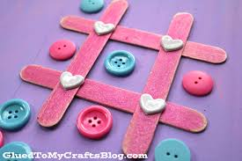
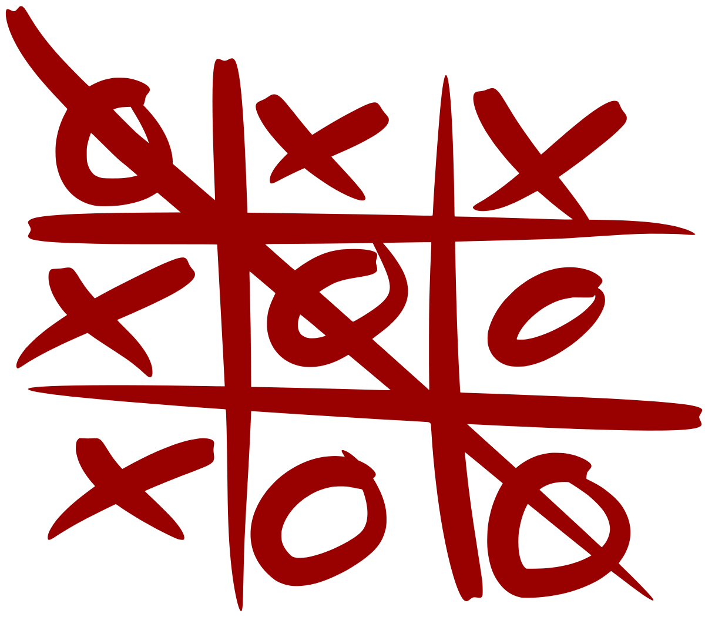
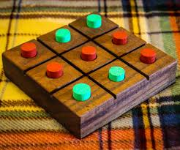
Tic Tack Toe Game

Slide 2
INTRODUCTION
Tic-tac-toe, also called noughts and crosses (in the British Commonwealth countries), Xs and Os (in Ireland) and X and 0 (in India) is a pencil-and-paper game for two players, X and O, who take turns marking the spaces in a 3×3grid. The player who succeeds in placing three respective marks in a horizontal, vertical, or diagonal row wins the game . The following example game is won by the first player, X: {Players soon discover that best play from both parties leads to a draw (often referred to as cat or cats game). Hence , tic-tac-toe is most often played by young children . The friendliness of tic-tac-toe games makes them ideal as a pedagogical tool for teaching the concepts of good sportsmanship and the branch of artificial intelligence that deals with the searching of game trees. It is straight forward to write a computer program to play tic-tac-toe perfectly, to enumerate the 765 essentially different positions (the state space complexity), or the 26,830 possible games up to rotations and reflections (the game tree complexity) on this space .

Slide 3
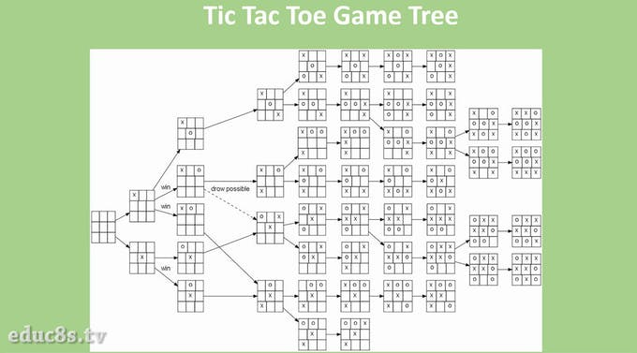

Slide 4
Strategy
Optimal strategy for player X. In each grid, the shaded red X denotes the optimal move, and the location of Os next move gives the next sub grid to examine. Note that only two sequences of moves by O (both starting with center, top-right, left-mid) lead toe draw, with the remaining sequences leading to wins from X.A player can play perfect tic-tac-toe (win or draw) given they choose the first possible move from the following list. Win : If the player has two in a row, he or she can place a third to get three in a row. Block : If the [opponent] has two in a row, the player must play the third himself or herself to block them. {Fork : Creation of an opportunity where the player has two threats to win (two non-blocked lines of 2).Blocking an opponents fork: Option 1: The player should create two in a row to force the opponent into defending, as long as it doesn't result in them creating a fork. For example, if "X" has a corner, "O" has the center, and "X" has the opposite corner as well, "O" must not play a corner in order to win. (Playing a corner in this scenario creates a fork for "X" to win.)Option 2: If there is a configuration where the opponent can fork, the player should block that fork. Center : A player marks the center. (If it is the first move of the game, playing on a corner gives "O" more opportunities to make a mistake and may therefore be the better choice; however, it makes no difference between perfect players.)Opposite corner : If the opponent is in the corner, the player plays the opposite corner.

Slide 5
APPLICATIONS
Various game shows have been based on Tic-Tac-Toe and its variants :-
On Hollywood Squares, nine celebrities filled the cells of the tic-tac-toe grid; players put symbols on the board by correctly agreeing or disagreeing with a celebritys answer to a question. Variations of the show include Storybook Squares and Hip Hop Squares.
In Tic-Tac-Dough, players put symbols up on the board by answering questions in various categories, which shuffle after each players turn.
In Beat the Teacher, contestants answer questions to win a turn to influence a tic-tac-toe grid.

Slide 6
On The Price Is Right, several national variants feature a pricing game called "Secret X," in which players must guess prices of two small prizes to win Xs (in addition to one free X) to place on a blank board. They must place the Xs in position to guess the location of the titular "secret X" hidden in the center column of the board and form a tic-tac-toe line across or diagonally (no vertical lines allowed). There are no Os in this variant of the game.
On Minute to Win It, the game Ping Tac Toe has one contestant playing the game with nine water- filled glasses and white and orange ping-pong balls, trying to get three in a row of either color. They must alternate colors after each successful landing and must be careful not to block themselves.

Slide 7
LIMITATIONS
This game cannot be played by one or more than 2 players.
2. It is not a high level game.
3. It doesn’t contain levels.

Slide 8
We have made this game using HTML, JAVA and CSS.
Team members :-
Sushil Kumar
Abhinav Pareek
Aman Khandelwal
Prince Chandra Shekhar

Slide 9
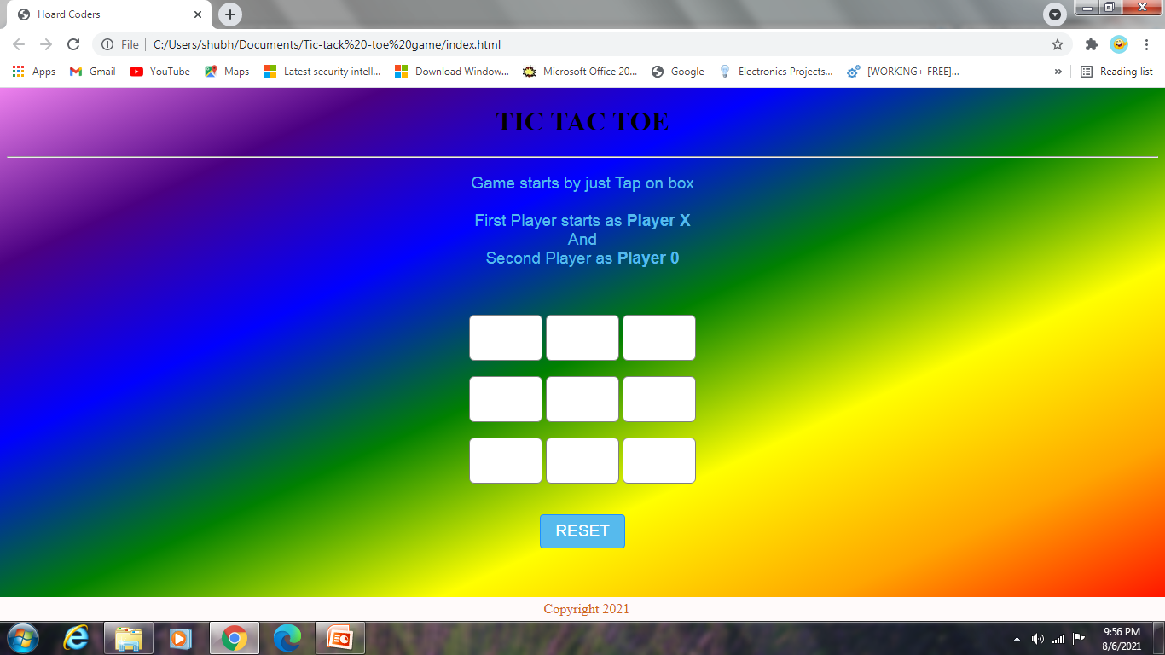

Slide 10
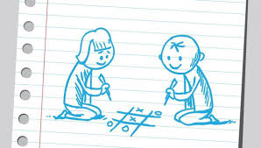
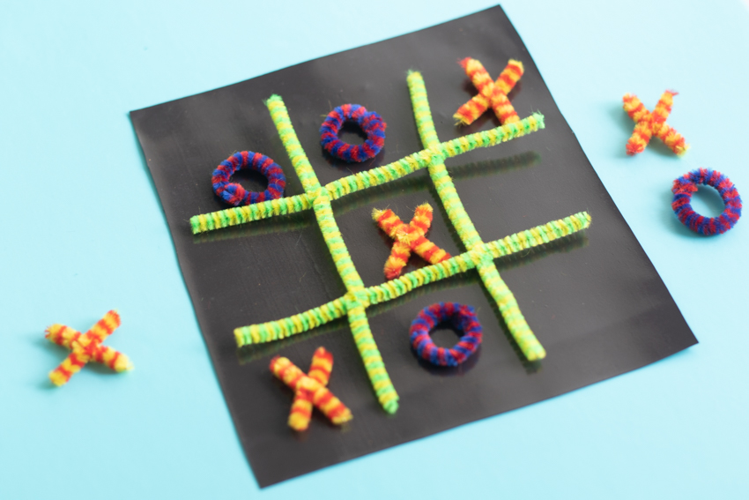
Thank You

